Slide 1
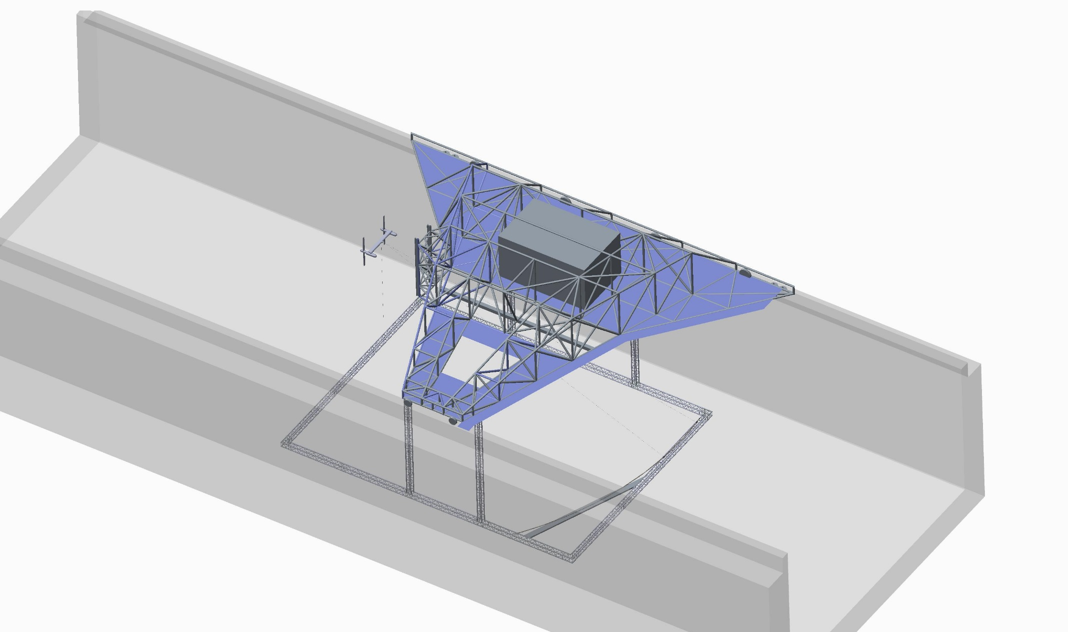
Tow Cube Design Overview

Slide 2
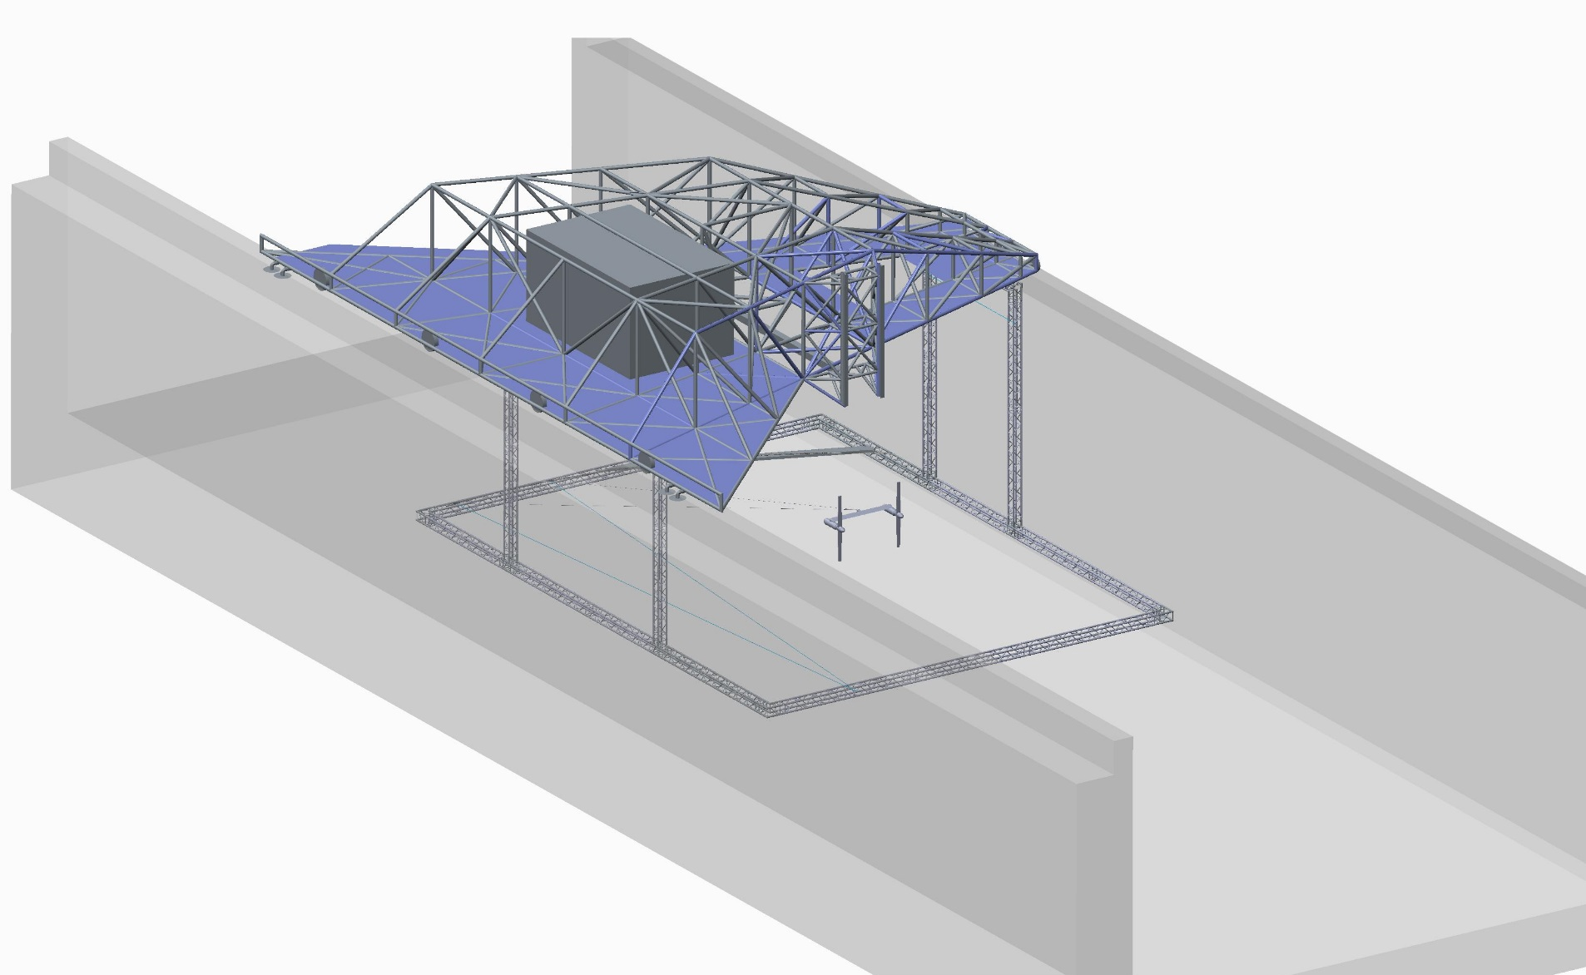
Tow Cube Design Overview

Slide 3
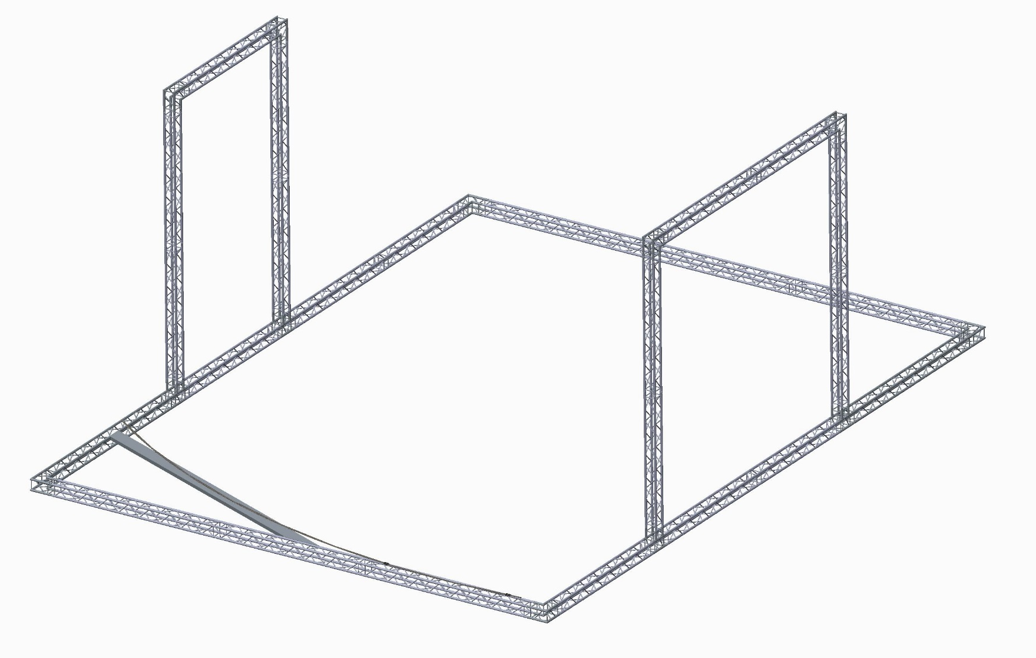
Tow Cube Design Overview
7 m
16.5 m
12.5 m

Slide 4
Tow Cube Design Overview

Slide 5
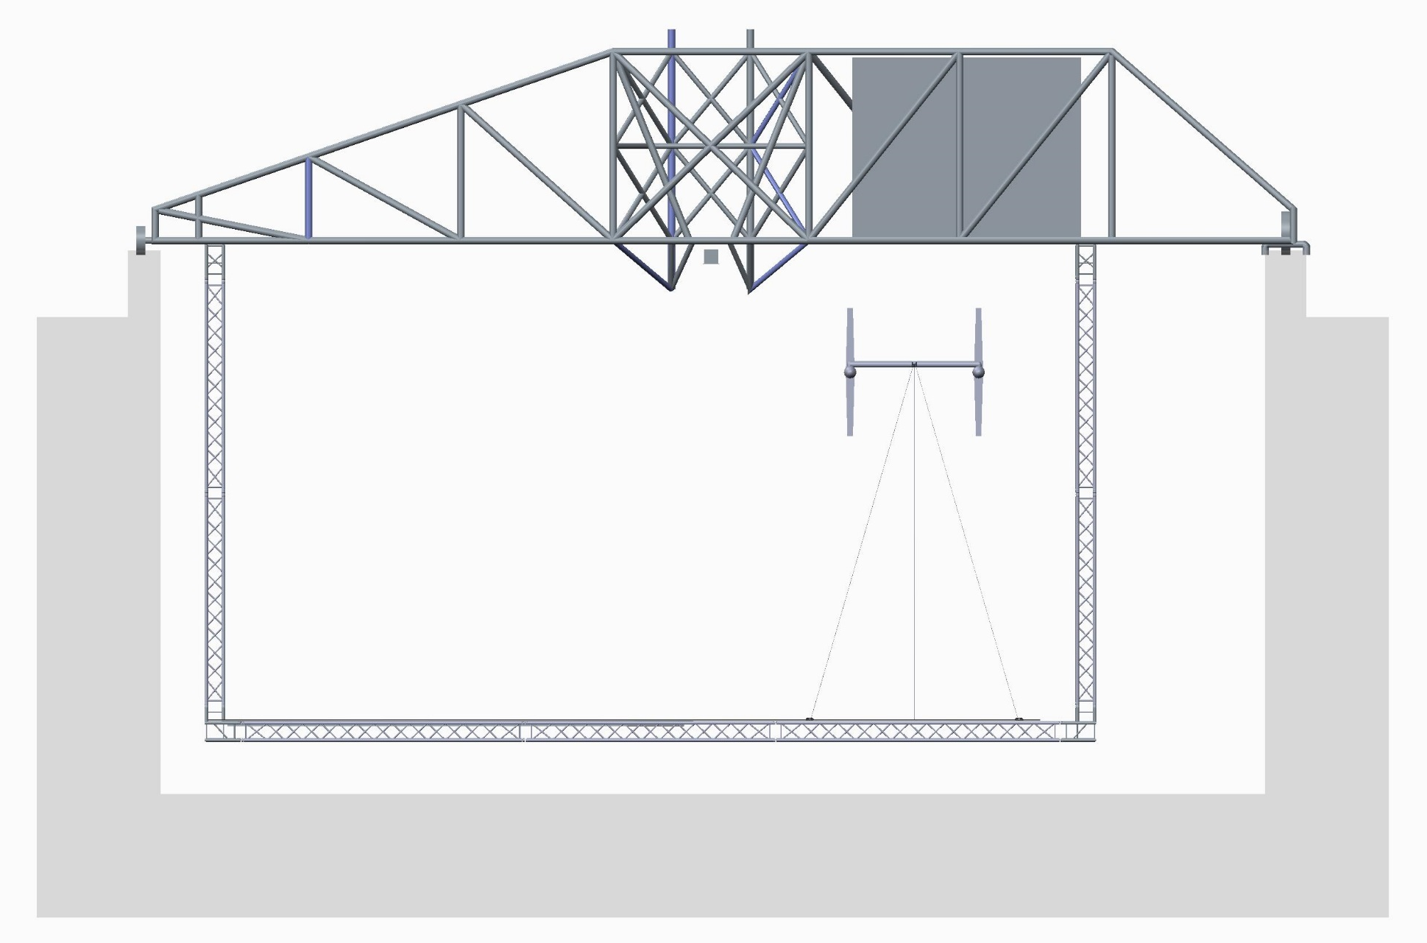
Tow Cube Design Overview

Slide 6
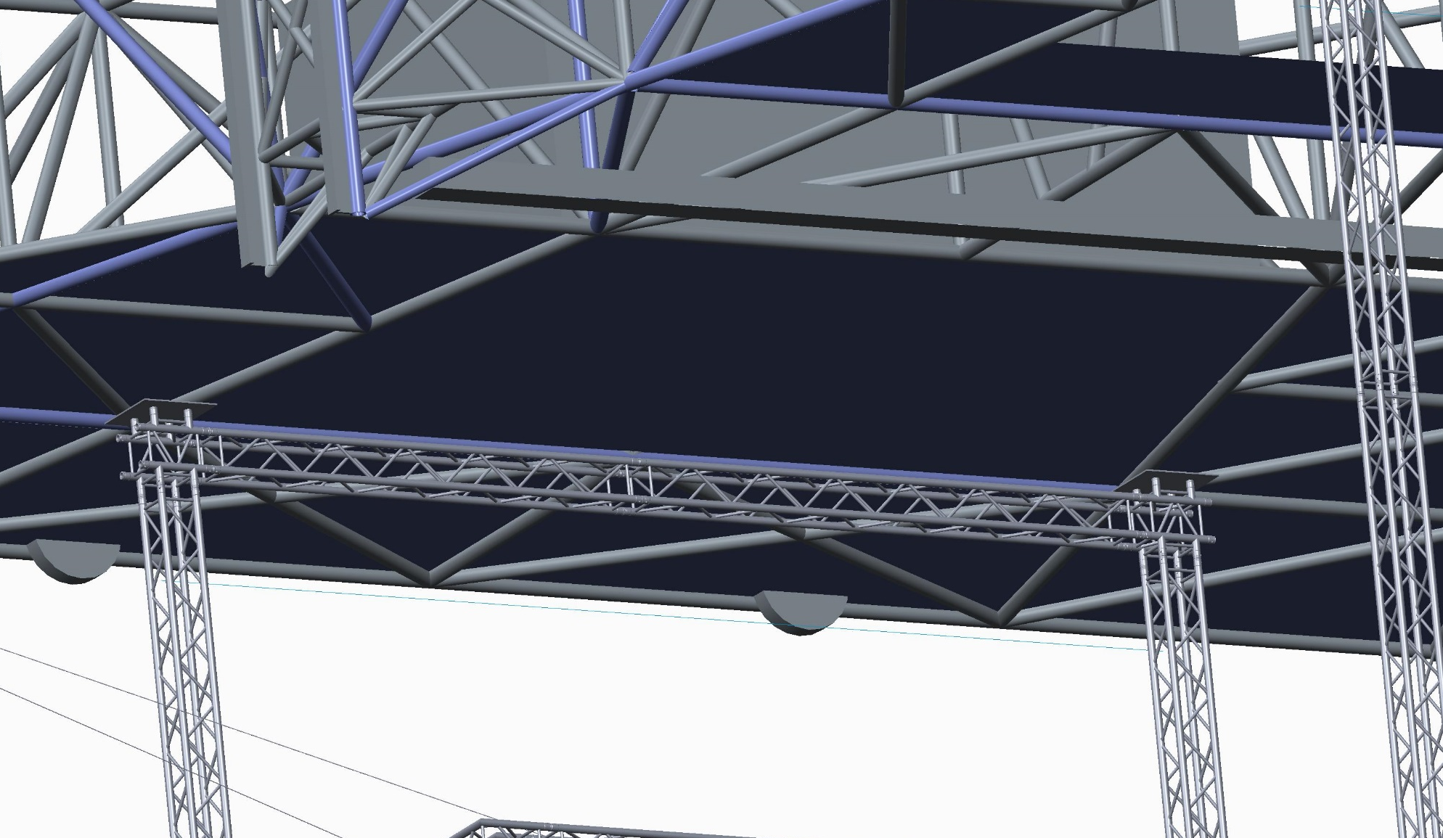
Attachment Plates

Slide 7
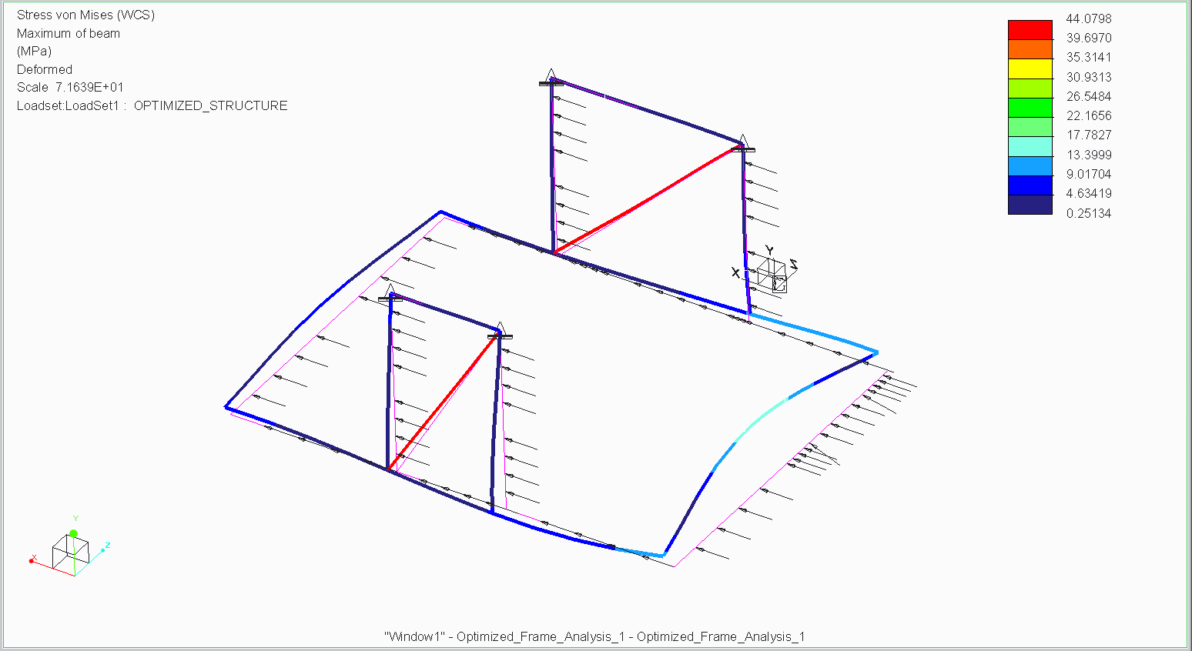
Preliminary Analysis (Stress)

Slide 8
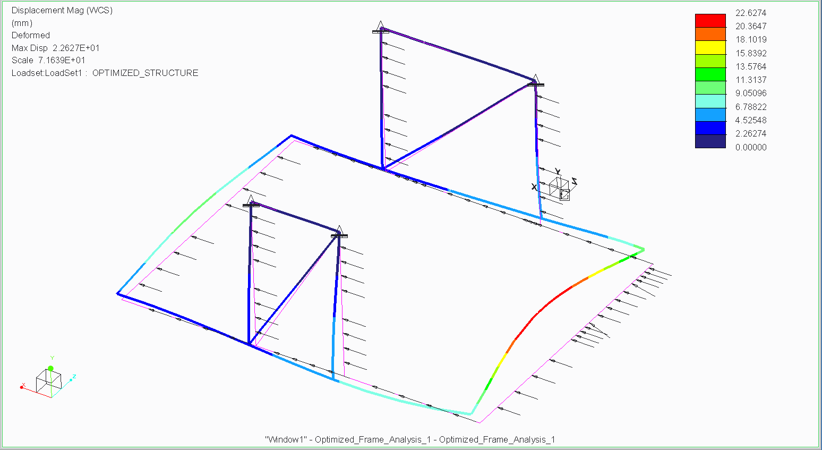
Preliminary Analysis (Displacement)

